Slide 1

Empowering Local Vendors: The Online Platform
Project Member:-
1.Shailendra Soni
3. Rishabh Singh Baghel
3.Santosh Udavant
4. Vishakha kirti

Slide 2
Content
Introduction
Objectives
Vendor’s Products/Service
Use case Diagram
Schema Diagram
Local Market Analysis
Website Feature
Payment Getaway Integration
Marketing and Promotion
Customer Support
Analytics and Reporting
Demo Receipt
Technology that we have used

Slide 3
Introduction
Idea
Our mission is to provide a platform for local vendors can sell their products online, reaching a wider audience and increasing their sales.
Local vendors are a growing segment of the market, with a demand for unique, locally-made products. There is a gap in the market for an online platform that connects these vendors with customers. A few competitors exist, but none specifically cater to local vendors.
Need for an E-Commerce Website in Today's Digital Era
Global Reach
Convenience
24/7 Accessibility
Digital Marketing Opportunities
Competitive Edge
Adaptation to Changing Consumer Behavior

Slide 4

Objectives
Clearly state the objectives of the e-commerce website
Increase sales and revenue.
Connect local vender each other.
Connect consumer to vendor at local level.
Expand customer reach.
Enhance customer experience.
Streamline business operations.
.

Slide 5
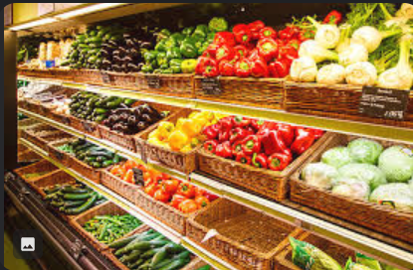

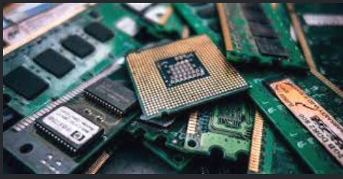

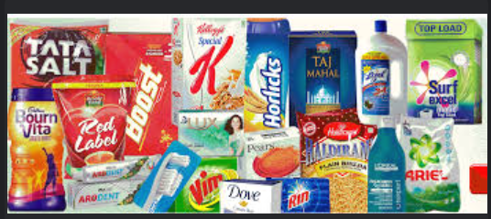

Vendor's Products/Services
Fresh Produce Section
Bakery Delights
Hardware Essentials
Local Artisan Crafts
Daily Groceries
Floral Arrangements

Slide 6
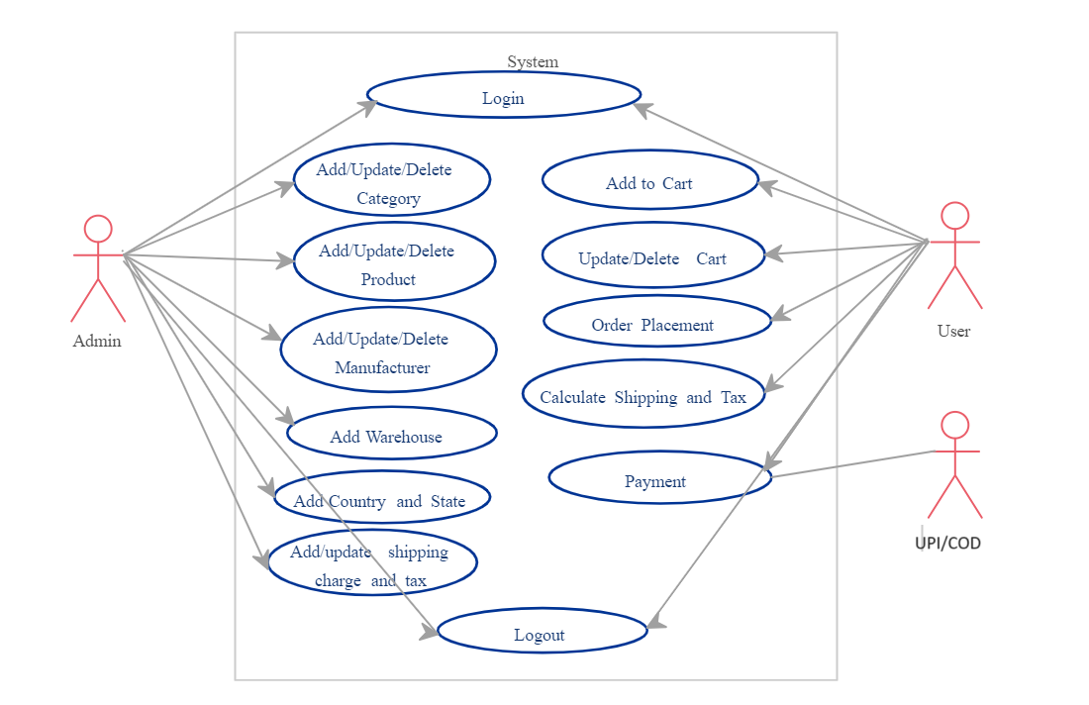
Use Case Diagram

Slide 7
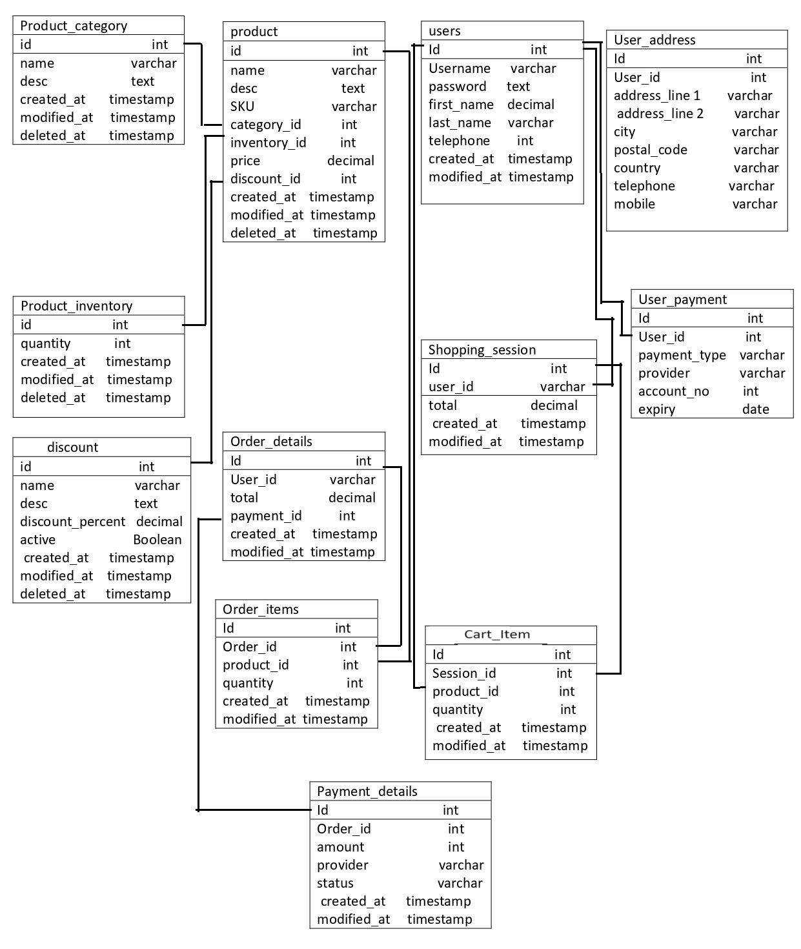
Schema Diagram

Slide 8
Local Market Analysis The Shop
Competitors:
Super Mart Plus:
Overview: A large supermarket chain offering a wide range of products, including groceries, electronics, and household items.
Strengths: Extensive product selection, competitive pricing, and loyalty programs.
Weaknesses: Limited focus on local, artisanal products; potential for impersonal shopping experience.
Tech Haven Electronics:
Overview: Specializes in electronic goods, gadgets, and tech accessories.
Strengths: Knowledgeable staff, exclusive tech offerings, and frequent promotions.
Weaknesses: Limited non-tech product variety, may not cater to diverse needs.

Slide 9
3.Nature's Bounty Organic Store:
Overview: A boutique store emphasizing organic and locally sourced products.
Strengths: Niche market appeal, emphasis on sustainability, and premium quality.
Weaknesses: Higher price points may limit mass appeal, smaller product range.
Market Trends:
Rise of Localism:
Observation: Consumers increasingly prefer locally sourced and artisanal products.
Opportunity: The local vendor can capitalize on this trend by promoting their existing range of locally produced goods and expanding partnerships with local artisans.
Digital Shopping Preferences:
Observation: A significant shift towards online shopping for convenience and time-saving.
Opportunity: Investing in an e-commerce platform can tap into this growing trend, allowing the local vendor to reach a wider audience and offer an additional channel for customers.

Slide 10
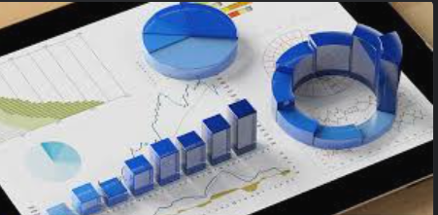
3.Sustainability Focus:
Observation: Consumers are becoming more environmentally conscious, seeking sustainable and eco-friendly products.
Opportunity: The local vendor can enhance its market position by promoting sustainable practices, such as reducing plastic use, sourcing local organic products, and engaging in community environmental initiatives.

Slide 11
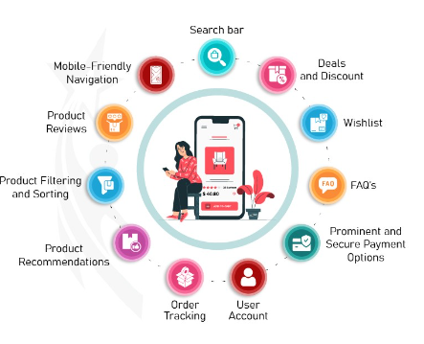
Website Features
Outline the key features of the e-commerce website.
User-friendly navigation.
Product catalog with detailed descriptions.
Shopping cart functionality.
Secure payment options.
Customer account management.

Slide 12
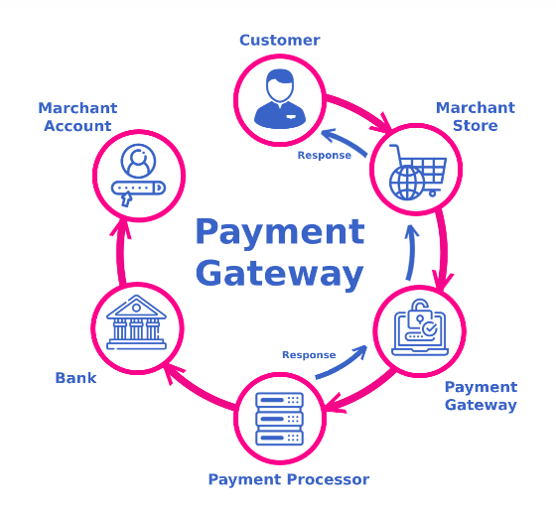
Payment Gateway Integration
Credit and Debit Cards:
Customers can securely make purchases using major credit and debit cards such as Visa, MasterCard, and American Express. This provides a familiar and convenient payment method for a wide range of users.
Digital Wallets:
Integration with popular digital wallets like PayPal and Apple Pay allows customers to make swift and secure transactions without entering card details. This enhances the overall convenience of the payment process.
Bank Transfers:
For customers who prefer direct bank transactions, the website supports bank transfers. This provides an alternative for those who may not have or prefer not to use credit or debit cards.
Cash on Delivery (COD) Option:
To cater to customers who prefer paying upon receipt of goods, the website also offers a Cash on Delivery (COD) option for eligible orders.

Slide 13


Marketing and Promotion
Present the marketing strategies for promoting the e-commerce website.
Social media marketing.
Email campaigns.
Loyalty programs.
Special promotions and discounts.

Slide 14

Customer Support
1. Live Chat Support:
A real-time live chat support system integrated directly into the website.
2. Email Support:
Dedicated email support accessible through a prominently displayed contact form on the website.
3. Phone Support:
Toll-free customer support hotline prominently displayed on the website.

Slide 15
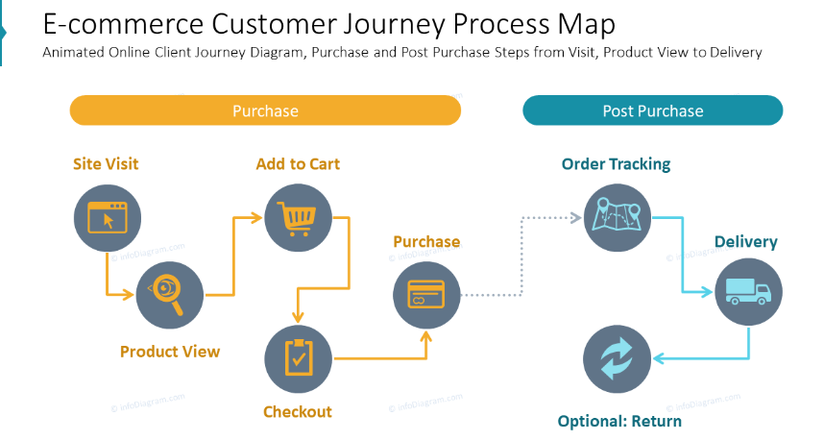
Analytics and Reporting
Sales Performance Metric
Customer Behavior Analysis
Marketing Channel Performance
Return on Investment (ROI)
Inventory and Supply Chain Metrics
Customer Satisfaction Metrics
Actionable Insights for Growth
Continuous Improvement Strategies

Slide 16
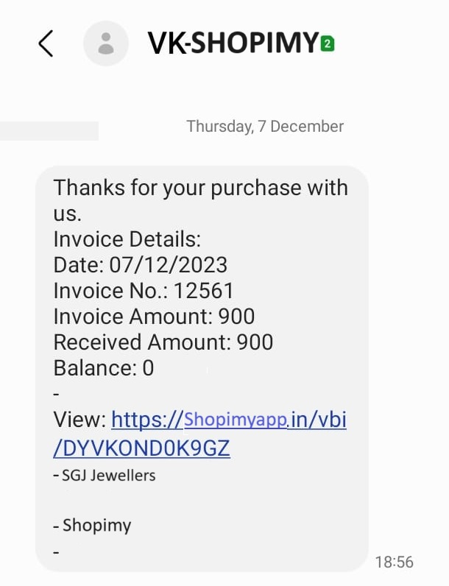
Demo Receipt

Slide 17
Technologies that we have used
Software
Operating System:
- Windows 7/8.1/10
MS Office
- MS Word, MS PowerPoint
Notepad ++
Required Hardware
Processor: 1 gigahertz (GHz) or faster processor
RAM: 1 gigabyte (GB) for 32-bit or 2 GB for 64-bit. Hard disk space: 16 GB for 32-bit OS 20 GB for 64- bit OS.
Programming Language
Front End:
- HTML, CSS, JavaScript
- Bootstrap, jQuery
Back End:
- Java , Mysql
Web Server:
- Apache V9.0

Slide 18

Any Question

Slide 19
Thank You

